Slide 1
What is different about the Market Systems Development approach? ‘A little MSD pedagogy’ Dr. Harald Bekkers, Cardno Emerging Markets (East Africa) Ltd. and Opportunities Unlimited B.V. Kampala, 15 October 2019

Slide 2
Notes:
To tell the story of MSD we must start with a farming couple, or a industrial worker, or whoever's life we seek to improve. They should be at the center of our thinking: how do we make them better off?
We know can give them our attention, love and more. In specific circumstances this is necessary. But for sustainable development at scale we need something else.

Slide 3
Thomas Thwaites: The Toaster Project
Notes:
For sustainable development for large numbers, ’at scale’, we need to look at systems. Even the simplest picture of a farming couple I could find contains something the farmer did not make himself > shovel. There is something around each farming couple. And this good: as the Toaster project suggests: it is not every efficient doing everything by yourself.

Slide 4
Notes:
Obviously a farmer couple could benefit from access to many things. How do we together with the farming couple what makes most sense?
First it helps to think in terms of functions.. If you want to rob a bank you need: a mask, gun, a bag and an inconspicuous getaway car.

Slide 5
Notes:
What do farmers need? What influences their abiliy to produce in a productive, sustainable, profitable manner
Go one by one. Seeds, fertizer, crop mgt, machinery, info, finance, logistics, market access, stable communities, financial policy, trade, research
This picture is not complete. Obviosly a lot goes into into this function !!!
Do we need to work on all of this?
If these are all elements of a production function, then there will always been needs and spaces to improve. Once we are aware of of this elaborare system around farmers we need to asses which functions are most impaired: they cause most trouble, most losses’ fixing them will generate most gains, and the incentives to get them fixed are strongest.

Slide 6
WorldFish breed & hatcheries
Feed mills (local) & distribution
Education on new ‘cash crop’
Investment capital
Processing industry & supply chain
Local research on breed, feed and diseases
Notes:
So how would this work, if say, someone would be interested in food and nutrition security. Let’s say we are interested in promotion aquaculture: natural fish stocks are depleting, fish is a good source of protein, it is an affordable protein, and it has a very small carbon footprint. Although not a staple yet, it is expected to grow exponentially.
What do we need? Where are the bottlenecks?
Breed + local hatcheries; feed formulas, local feed mills for affordable feed, Edu, money, logistics to keep fish fresh, bring it to consumers, RESEARCH
Many different partners, diffetnt support arrnagements, diffeetn timelies, ONE COMMON STRATEGY

Slide 7
A systems approach is based on:
A multi-actor strategy defining need and potential
Partnerships with system actors based on ‘appropriate roles for appropriate players
Credible ownership, incentives, capabilities
Real innovation
Informed facilitation (not funds administration)
Tailored support packages (not buying friendship, not artificially ‘cold’ – IN PARTNERSHIP)
Continuous learning (e.g. supported by DCED Standard)
Notes:
Does the logic still holds if Arno wants to focus on food industries? YES!!!
A system always comprises of
Production inputs
Commercial services
The rules and conventions established by formal and informal institutions
There are always different market segments with different growth potential and different requirements

Slide 8
Market System Diagram
Production inputs: e.g., agricultural inputs, equipment, capital investment, land, labor
Embedded services may be provided along with these
Business services: e.g., financial services, technical services, business development services, information services, logistics, labor services/skill development
Business enabling environment: formal and informal institutions regulating economic activity, e.g., laws/regulation, polices, representation and voice, social norms, informal networks
THANK YOU!
For more information:
hbekkers@business4development.com
Markets are supplied with competitive products that are in demand and fetch a fair price
Notes:
Does the logic still holds if Arno wants to focus on food industries? YES!!!
A system always comprises of
Production inputs
Commercial services
The rules and conventions established by formal and informal institutions
There are always different market segments with different growth potential and different requirements

Slide 9
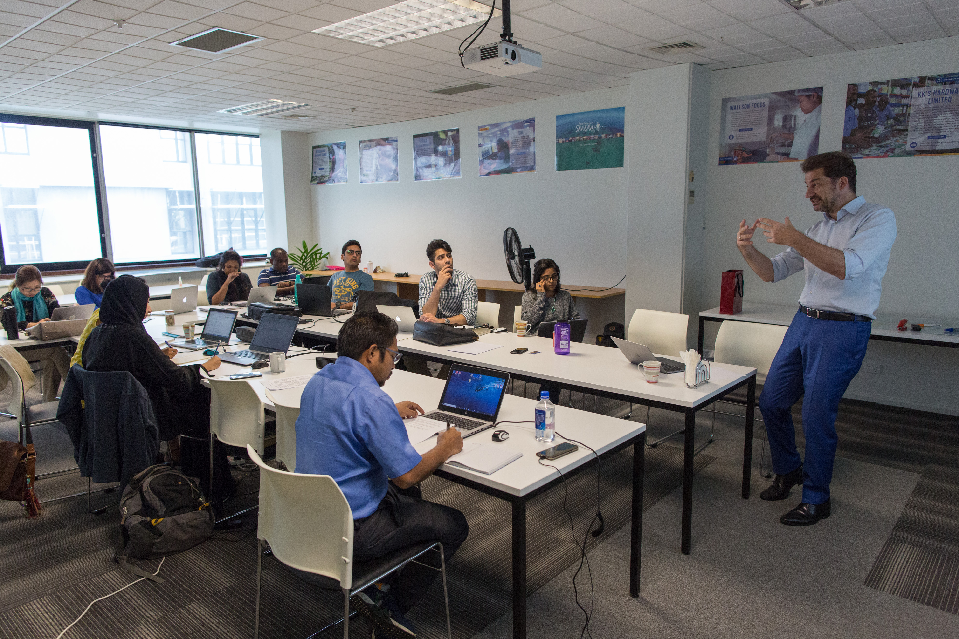
Notes:
Explain package:
How you select the sectors in which you work; how you analyze these, and whom should do this
How you will reach your beneficiaries; and to what extent you can ‘’target’
Which activities you need to deploy, and whether these are standard or ‘innovative’
How you organize your team / organization, what it does
Where you locate your office

