Slide 1
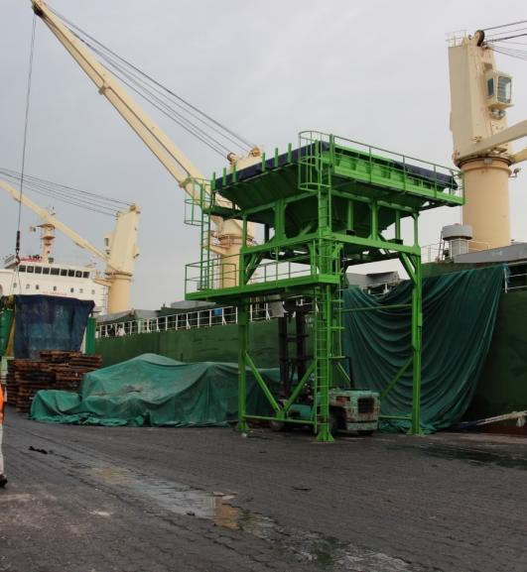
Cost build up webinar – Sept 28, 2020 FERTILIZER IMPORT PROCESS MAPS
Main Findings of the Fertilizer Cost build up and process maps studies
Patrice ANNEQUIN Fertilizer Market Specialist | EnGRAIS | IFDC

Slide 2
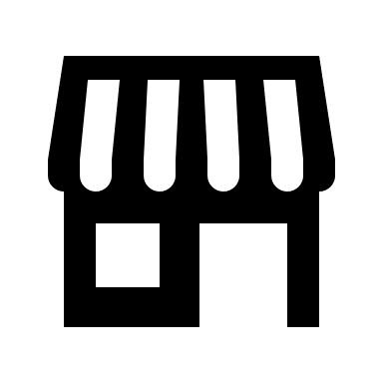
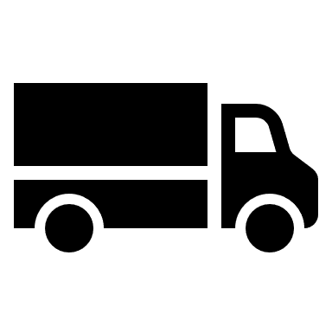
The Fertilizer Journey
Manufacturer/Trader
Importer/Blender
Distributor
Wholesaler
Retailer
Farmer
Notes:
The Manufacturer Mines and/Or transforms the raw material into Urea, DAP, MOP or NPK
Which is Sold Directly or Through a Broker to an importer
Some times at a price that includes the Freight C+FR
The Importer pays for the Insusrance; The Port charges, including Stevedoring, Freight Forwarding fees, Port fees, other Admin Cost,
Since the Product needs to be blended in the destination country, it is bagged at the receiving port transported to the importing country where it is cleared at custom, unbagged, blended and bagged again.
From this point onward the Fertilizer passes through the hands of several middlemen before reaching the Farmer.
At each level Transport, handling and a margin are added to the cost.
This is how the fertilizer arrives at Salif at 160 Dollars for 5 Bags.

Slide 3
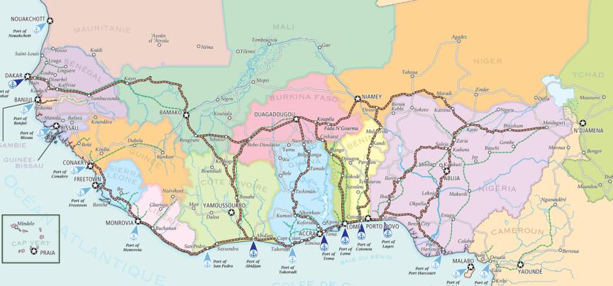
Main fertilizer imports and re-export flows (in ‘000 tons)
6 countries : 1.8 - 2 million MT
50% to Mali and Burkina Faso
Production plants
imports
ICS
125 kt
Blending plants
re-exports
Toguna
45 kt
Dakar
25
25
Abidjan
Tema
Lome
Notes:
Le Burkina est clairement le marché sur lequel la competition est la plus forte avec 4 portes d’entrées

Slide 4
Various market procurement patterns
 | Senegal | Mali | Côte d’Ivoire | Burkina Faso | Ghana | Togo
Public tenders | 75% | 90% (cotton, cereals, rice) | 5% (projects & programs) | 5% (projects & programs) | 75% (cocoa, cereals, rice) | +/- 5% (projects & programs)
Private tenders | 10% (4 cotton companies) |  | 35% (4 cotton companies) | 80% (3 cotton companies) | 5% (3 cotton companies) | 60% (NSCT and FUPROCAT)
Open market large farms and coops | 7.5% (sugar cane, horticulture) | 5% (sugarcane) | 20% (sugarcane, oil palm, banana) | 5% (sugarcane) | 15% (palm, banana, etc.) | 5% (pineapple, soy, etc.)
Open retail market (small and medium-sized farms) | 7.5% (mainly vegetables) | 5% (mainly vegetables) | 40% (cocoa, vegetables, cereals) | 15% (vegetables, cereals, sesame) | 5% (vegetables, cereals) | 30% (vegetables, cereals, cocoa)
Estimates by the consultants

Slide 5
Marketing to the coastal countries
Processing and Storage
by Importers and/or Blenders
50% Blending + bagging 25 to 70 USD/t 40% Bagging 10 to 50 USD/t
5% Direct sales 2 to 5 USD/t
5% Direct Imports 5 to 20 USD/t
Ground Transport Deliveries to
5 to 75% institutional markets/subsidies 15 to 45 USD/t
5 to 60% structured private market 15 to 45 USD/
15 to 60% open market 15 to 45 USD/t
Sales / Distribution
5 to 35% Sales to large farms Wholesale prices
5 to 10% Sales to cooperatives and farmers’ groups 5 to 15 USD/t
5 to 30% Sales to distributors 15 to 30 USD/t 5 to 30% Retail sales to small and medium farmers Retail prices: 375 to 600 USD/t
Unloading
40% Bulk to dump truck 14 to 17 USD/t
40% BiBo Bulk In/Bag Out 28 to 32 USD/t
10% Bags to trailer truck /train 18 to 21 USD/t
10% Containers ex-port to trucks 15 to 18 USD/t
Shipping
80% Bulk 20 to 40 USD/t
10% Break Bulk (50 kg bags or big bags) 25 to 45 USD/t
10% Containers (50 kg bags or big bags)
35 to 55 USD/t
Fertilizer Products
45% Straight products (urea, DAP, KCl, etc.) 180 to 700 USD/t
30% Blending ingredients (TSP, MAP, SoA, fillers ..) 100 to 400 USD/t
25% NPK Compounds (NPK+S +/- micronutrients) 200 to 500 USD/t
FOB price
Sea freight
Port charges
Processing charges
Transport charges
Costs & Margins

Slide 6
Marketing to the hinterland (Mali, Burkina Faso)
Shipping
75% Bulk 20 to 40 USD/t
15% Break Bulk (50 kg bags or big bags) 25 to 45 USD/t
10% Container (50 kg bags or big bags)
35 to 55 USD/t
Unloading
60% BiBo Bulk In/Bag Out 28 to 32 USD/t
25% Bulk to dump truck 14 to 17 USD/t
15% Bags to trailer truck /train 18 to 21 USD/t
5% Containers ex-port to trucks 15 to 18 USD/t
Transit
70% Direct transit (land transport by forwarder) 60 to 100 USD/t
30% Indirect transit (hinterland importer buy from port importers) 65 to 105 USD/t
Processing and Storage
by Importers and/or Blenders
55% Blending + bagging 20 to 50 USD/t
30% Bagging 5 to 40 USD/t
10% Direct sales 2 to 5 USD/t
5% Direct Imports 5 to 20 USD/t
Ground Transport Deliveries to
5 to 90% institutional markets 15 to 45 USD/t
0 to 80% structured private market 15 to 45 USD/t
10 to 20% open market 15 to 45 USD/t
Sales / Distribution
5% Sales to large farms Wholesale prices
5% Sales to cooperatives and farmers’ groups 5 to 15 USD/t
5 to 15% Sales to distributors 15 to 30 USD/t 5 to 15 % Retail sales to small and medium farmers Retail prices: 475 to 600 USD/t
Sea freight
Port charges
≈
Processing charges
Transport charges
Costs & Margins
Transit charges

Slide 7
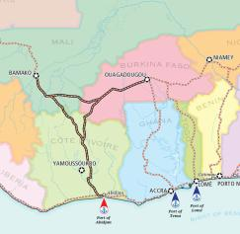
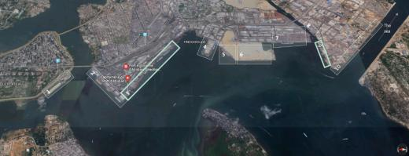
Fact Sheet - Port Autonome d’Abidjan
Storage Area | Bonded Warehouses | Max bulk carrier | Bulk Fertilizer Unloading Capacity | Bulk Waiting Time (days) | Time on Dock Bulk Carrier in Port (days)
19 areas 250,000 m² | 18 warehouses 134,614 m² | Handysize 30,000 t | 3 to 5,000 tons/day * 2 docks | Avg: 3 Min: 0.6 Max: 37 | Avg: 5.4 Min: 0.7 Max: 9
Notes:
(darft

Slide 8
Fertilizer Import Procedures via the PAA [Abidjan]
Before Signing the Import Contract
1.1 Fertilizer import contract (DGPSA)
1.2 Annual import code (Min. Trade)
1.3 Supplier quotation
1.4 VAT exemption (DGPSA)
1.5 Import Prior Authorization (API) (DGPSA via GUCE)
1.6 Import Declaration Form (FDI) (GUCE)
Maritime Transport
3.1 Transmit COC to VOC
3.2 Cargo tracking note (CTN) from OIC
3.3 Obtain a Value Classification Final Report (RFCV) at GUCE
3.4 Freight forwarder and port handling contracts
3.5 Local insurance for unloaded goods
Prior to shipment
2.1 Import contract signature
2.2 Contract with maritime carrier + insurance
2.3 Compliance check of the shipment by a certified controlling company with mandatory physical inspection of fertilizers to obtain a Certificate of Conformity (COC)
Clearance or Transit
5.1 Direct import (CI customs clearance) Customs entry via SYDAM (Sydonia World) → Customs payment → Receipt Good to Remove (BAE) 5.2 Direct transit (clearance in Mali or Burkina Faso): EX3000/T1 declaration (customs CI Mali BF) via SYDAM → Transit warehouse storage → RGF payment+installation GPS → BAE tag
Unloading
4.1 Request to berth and approach by consignee, then berthing
4.2 Onboard handling (unloading)
4.3 Bill of lading (BL) exchange from consignee to the freight forwarder
Ex-Port and Delivery \
6.1 Port delivery: unpack and/or truck loading by the importer or its carrier in the port, exit with BAE 6.2 Delivery to importer’s warehouse: Shipping carrier, freight forwarder, or land handler deliver to importer 6.3 Delivery in Mali or Burkina Faso: Freight forwarder organizes transport to importer’s warehouse and pays customs fees at land border

Slide 9
Process duration: 1 to 4 months!
Before Signing the Import Contract
Obtaining importer code: 1 to 2 days.
Obtaining approval: about 1 month, carried out before the import season
API and FDI: 2 to 5 days
Maritime Transport
Shipping time: depending on country of origin, from 5 days (Morocco) to 30 days (Black Sea, China)
Prior to shipment
From contract signing to ship loading:
5 to 10 days
Unloading
From arrival of the ship to unloading:
5 to 40 days, depending on congestion
Ex-Port and Delivery
Release for local consumption: 10 to 25 days from unloading to exit from the port,
Transit: 20 to 45 days from unloading to removal from the port, plus 4 to 10 days to exit from the port and deliver to Mali or Burkina Faso

Slide 10
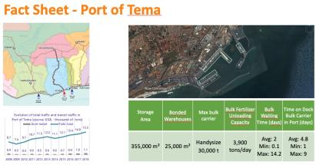

Slide 11
Comparing Ports – Overall competitiveness
 | Advantages | Disadvantages | Anticipated Changes
Dakar | Lower cost and duration of freight Close to Eastern and Central Mali Berths dedicated to transit to Mali | Very high traffic congestion Low land availability/high cost of storage Relatively high port fees | New bulk carrier quay to be built soon on the new outer port of Dakar
Abidjan | Can serve both Mali and Burkina Faso Higher export rate than other ports Availability of a railway line | Higher port fees heavy maritime and road congestion BiBo operations restricted | Port extension in progress
Tema | Lower port fees than in other ports Reduced port and road congestion Land availability Most competitive port to supply Burkina Faso | Poor road infrastructure in Tema area English / French language barrier Less efficient customs cooperation for transit Currency volatility, high bank interest rates | Recent opening of the new container terminal Cooperation between customs in Burkina Faso and Ghana
Lomé | Deep-water port (up to 60,000 tons vessels) Correct land availability Closer to serve Eastern Burkina Faso | Port oriented toward container traffic and under-equipped for bulk unloading Relatively small local market | Administrative and logistical facilities for transit to Burkina Faso and Niger

Slide 12
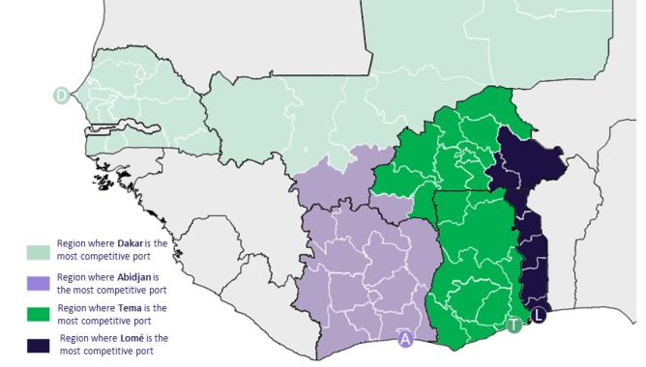
Comparing Ports – Overall competitiveness
Dakar
Lomé
Abidjan
Tema
Notes:
Kido will detail the COSTS

